Slide 1

Research on Risk and Estimating
NCHRP Research Report 1025
Contingency Factors to Account for Risk in Early Construction Cost Estimates for Transportation Infrastructure Projects
August 22, 2023
H. David Jeong, Ph.D.,
Texas A&M Transportation Institute
Texas A&M University

Slide 2
NCHRP Research Report 1025:
Contingency Factors to Account for Risk in Early Construction Cost Estimates for Transportation Infrastructure Projects
https://nap.nationalacademies.org/download/26829

Slide 3
Why ? - Construction Cost Certainty !
Scoping Phase
Planning &Programming
Preliminary Design
Final Design
Construction
$
$
$
Early Estimate
Engineer’s Estimate
Actual Cost
Significant variation between early estimate and construction costs may lead to delaying, adding, or cancelling projects. Reallocation of funds or additional funds are needed.
Use of contingency factors is a good approach to addressing potential cost risks
Inconsistent and inaccurate application of contingency factors is a problem.

Slide 4
NCHRP Research Report 1025
1. Introduction
﻿A guidebook for developing early estimates of contingency factors for common project-related risks that affect construction costs.
The report will be of interest to those at state DOTs who are responsible for developing early construction cost estimates for projects, as well as for those who track program-level construction costs.

Slide 5
Report Structure
Introduction
Key Concepts – Construction Contingencies
Estimation Methods for Construction Contingencies
Major Risks for Construction Contingency Consideration
Guidance on Risk-Driven Approach for Estimating Construction Contingencies
Guidance on Historical Data-Driven Approach for Estimating Construction Contingencies
Guidance on Tracking and Monitoring Construction Contingencies

Slide 6

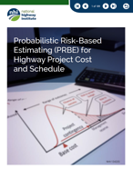
Key Concepts and Components of Construction Cost Contingency
2. Key Concepts – Construction Contingencies
Inconsistencies in DOT manuals and guidelines
Inconsistencies in DOT practitioners’ perceptions
(From Survey)
FHWA definitions adopted by the research team

Slide 7
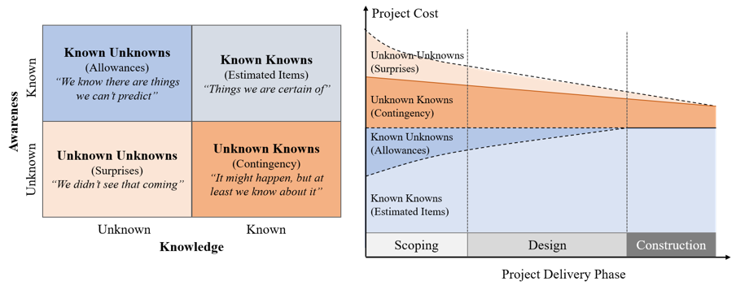
Major Elements of Construction Cost Estimate
2. Key Concepts – Construction Contingencies
Contingency - Unknown Knowns
Early Estimate = Base cost (itemized costs + allowance) + Contingency

Slide 8
Construction Cost Contingency Coverage
2. Key Concepts – Construction Contingencies
No. | States | Risks realized during construction | Scope change | Minor item allowance | Scope creep
1 | Alaska | ● | □ | □ | □
2 | California | ● | □ | ● | □
3 | Colorado | ● | □ | ● | □
4 | Connecticut | ● | ● | X | □
5 | Florida | □ | □ | ● | □
6 | Georgia | ● | X | □ | □
7 | Idaho | ● | X | X | □
8 | Illinois | ● | X | ● | □
9 | Indiana | ● | X | ● | □
10 | Iowa | ● | □ | ● | □
11 | Michigan | □ | ● | ● | □
12 | Minnesota | ● | ● | X | □
13 | Montana | ● | ● | □ | ●
14 | Nevada | ● | X | X | □
15 | New York | ● | □ | ● | □
16 | North Carolina | ● | □ | □ | □
17 | Ohio | ● | □ | □ | □
18 | Pennsylvania | ● | X | X | □
19 | Texas | ● | □ | X | X
20 | Utah | ● | □ | ● | □
21 | Washington | ● | □ | ● | □
*Note: ●: Included, X: Not included, and □: Not specified

Slide 9
Construction Cost Contingency – Definition
2. Key Concepts – Construction Contingencies
Construction Cost Contingency
  Unknown knowns
  Identified Risks
Construction Cost Contingency should not include
  Allowances (x)
  Major Scope Change (x)

Slide 10
Construction Contingency Estimating Methods
3. Estimation Methods for Construction Contingencies
Contingency estimating methods
Deterministic approach
Determine a single point estimate.
Appropriate when estimators are familiar with the type of the project from their experience.
Deterministic approach
Probabilistic approach
Fixed percentage
Expected value
Probabilistic approach
Sliding scale
Monte-Carlo simulation
Modeling uncertainty through statistical techniques.
Quantify risk impacts of probability with given project information.
Expert judgment
PERT
Parametric estimating

Slide 11
Contingency Estimating Methods
3. Estimation Methods for Construction Contingencies
No. | State | Fixed Percentage | Sliding Scale | Expected Value | Monte Carlo Simulation
1 | Alaska |  | ●
2 | California |  | ● | ● | ●
3 | Colorado | ● |  | ●
4 | Connecticut |  | ●
5 | Florida | ● |  | ●
6 | Georgia |  | ●
7 | Idaho |  | ● | ●
8 | Illinois |  | ●
9 | Indiana |  | ●
10 | Iowa | ●
11 | Michigan |  | ● | ●
12 | Minnesota |  | ● | ● | ●
13 | Montana |  | ●
14 | Nevada |  | ● | ● | ●
15 | New York |  | ● | ●
16 | North Carolina | ●
17 | Ohio |  | ●
18 | Pennsylvania |  | ●
19 | Texas |  | ● | ● | ●
20 | Utah | ●
21 | Washington |  | ● | ● | ●
Total |  | 5 | 16 | 10 | 5
A review of cost estimating manuals and risk management guides
24% 76% 48% 24%

Slide 12
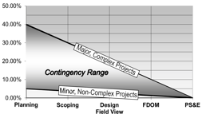
Deterministic approach
3. Estimation Methods for Construction Contingencies
Fixed percentage of base cost
Sliding Scale
Expert Judgment
The simplest method.
A pre-determined percentage of the base cost.
A range of percentages.
Different ranges for different project conditions
Use estimator’s personal experience and judgement.
Reflect project specific characteristics.
Project development stage | Contingency for roadway portion | Contingency for structure portion
Feasibility | +55% | +15%
Functional | +45% | +15%
Preliminary | +35% | +10%
At ROW | +25% | +10%
Final preliminary | +15% | +5%
Define decision problems
Recruit experts
Collect expert judgement
Analyze expert judgement
(Pros) Simple, straightforward, and available when useful project information is insufficient.
(Cons) Accuracy is dependent upon cost estimator’s experience and expertise.

Slide 13
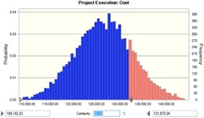
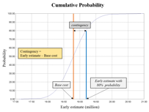
Probabilistic approach
3. Estimation Methods for Construction Contingencies
Expected value
Risks | Occurrence (%) (A) | Impacts ($) (B) | Contingency ($) (A)*(B)
Known Hazardous Substance | 10 | 125,000 | 12,500
Coordination with Railroad Agencies | 10 | 50,000 | 5,000
Treatment of Water Discharged from Site | 3 | 400,000 | 12,000
Total |  | 29,500 | 29,500
Identify project-specific risks and evaluate the probability and impact of the identified risks.
Require detail project information.
Monte Carlo simulation
A sophisticated computer-based probabilistic method.
Provide more realistic contingencies through a range of possible values.
(Pros) Can reflect project-specific characteristics and conduct more flexible contingency estimates.
(Cons) Requires more time and effort to perform it.

Slide 14
Major Risks for Construction Contingency Estimating
4. Major Risks for Construction Contingency Consideration
Top risk identification process
1. Analysis of DOT risk checklists and risk registers
2. Find risks through discussions with DOTs
3. Assess risk occurrences and impact magnitude
4. Prioritize top 12 risks
The list of 23 risks
Determined top 12 risks

Slide 15
Top 12 Major Risks
4. Major Risks for Construction Contingency Consideration
23 risks for contingency estimating
Prioritized Top 12 risks
Utility issues
Unexpected geotechnical issues
Constructability issues
Railroad involvement
Late changes requested by stakeholders
Errors in cost estimating
Maintenance of traffic/work zone traffic control
Unknown or change in current asset conditions
Unexpected archeological or historic findings
Endangered/protected species encountered during construction
Issues with new materials, technologies, and methods
Coordination with other projects
Poor or incomplete project scope definition during the scoping phase
Design changes
Contractor availability and competition
Market conditions
Project duration-related issues
Funding availability
Hazardous materials encountered during construction
Coordination with government agencies
Surveys late or in error
Political risks
Unanticipated noise impacts and noise mitigation
Ranking | Risk
1 | Utility issues
2 | Poor or incomplete project scope definition during the scoping phase
3 | Unexpected geotechnical issues
4 | Design changes
5 | Constructability issues
6 | Contractor availability and competition
7 | Railroad involvement
8 | Market conditions
9 | Late changes requested by stakeholders
10 | Project duration-related issues
11 | Errors in cost estimating
12 | Funding availability

Slide 16
Workflow of Estimating Contingency for High Priority risks
5. Guidance on Risk-Driven Approach for Estimating Construction Contingencies
1. Determine project characteristics, conditions, and environments
Is there any trigger?
No
Stop
Yes
3. Conduct qualitative assessment
2. Contact subject matter experts (SMEs)
Is this risk significant?
No
Stop
Help more thorough and comprehensive risk considerations.
Can reflect project characteristics rather than simply apply pre-defined percentages
Yes
4. Gather information & data from SMEs
5. Determine the probability and cost impact of the risk
6. (Optional) Select a response strategy & determine residual contingency
Output the contingency amount for the risk

Slide 17
Step 1
5. Guidance on Risk-Driven Approach for Estimating Construction Contingencies
1. Determine project characteristics, conditions, and environments
Is there any trigger?
No
Stop
Yes
3. Conduct qualitative assessment
2. Contact subject matter experts (SMEs)
Is this risk significant?
No
Stop
Step 1: Determine project characteristics, conditions, and environments
Yes
4. Gather information & data from SMEs
Gather key project information from scoping reports, including characteristics, conditions, and environments.
Identify the triggers for each of the top risks.
5. Determine the probability and cost impact of the risk
6. (Optional) Select a response strategy & determine residual contingency
Output the contingency amount for the risk

Slide 18
Step 2
5. Guidance on Risk-Driven Approach for Estimating Construction Contingencies
1. Determine project characteristics, conditions, and environments
Is there any trigger?
No
Stop
Yes
3. Conduct qualitative assessment
2. Contact subject matter experts (SMEs)
Is this risk significant?
No
Stop
Yes
Step 2: Contact subject matter experts (SMEs)
4. Gather information & data from SMEs
SMEs can provide valuable input and help validate project cost estimates.
Early cost estimators can contact relevant SMEs to get more information on the risks.
5. Determine the probability and cost impact of the risk
6. (Optional) Select a response strategy & determine residual contingency
Output the contingency amount for the risk

Slide 19
Step 3
5. Guidance on Risk-Driven Approach for Estimating Construction Contingencies
1. Determine project characteristics, conditions, and environments
Is there any trigger?
No
Stop
Yes
3. Conduct qualitative assessment
2. Contact subject matter experts (SMEs)
Is this risk significant?
No
Stop
Step 3: Conduct qualitative assessment
Yes
4. Gather information & data from SMEs
Evaluate the risk’s significance on the project.
Assign scores from 1 to 5 to the risks in terms of occurrence probability and their impacts.
5. Determine the probability and cost impact of the risk
6. (Optional) Select a response strategy & determine residual contingency
Output the contingency amount for the risk
Notes:
I

Slide 20
Step 4
5. Guidance on Risk-Driven Approach for Estimating Construction Contingencies
1. Determine project characteristics, conditions, and environments
Is there any trigger?
No
Stop
Yes
3. Conduct qualitative assessment
2. Contact subject matter experts (SMEs)
Is this risk significant?
No
Stop
Yes
Step 4: Gather information & data from SMEs
4. Gather information & data from SMEs
Gather information and data from SMEs that can serve as a reference for early cost estimators.
5. Determine the probability and cost impact of the risk
6. (Optional) Select a response strategy & determine residual contingency
Output the contingency amount for the risk

Slide 21
Step 5 and Step 6
5. Guidance on Risk-Driven Approach for Estimating Construction Contingencies
1. Determine project characteristics, conditions, and environments
Is there any trigger?
No
Stop
Yes
3. Conduct qualitative assessment
2. Contact subject matter experts (SMEs)
Is this risk significant?
No
Stop
Step 5: Determine the probability and cost impact of the risks
Yes
Estimate the risk’s impact (optimistic (O), most likely (M), and pessimistic (P)).
The average impact: I = (O+4M+P)/6.
Contingency amount = Pr x I
4. Gather information & data from SMEs
5. Determine the probability and cost impact of the risk
6. (Optional) Select a response strategy & determine residual contingency
Step 6: (Optional) Select a response strategy & determine residual contingency
Output the contingency amount for the risk

Slide 22
Overall Process of Historical Data-Driven Approach
6. Guidance on Historical Data-Driven Approach for Estimating Construction Contingencies
1. Historical Cost Data Collection
2. Data Cleaning and Pre-processing
3. Data Analysis and Project Characterization
4. Model Development
5. Apply Model to Projects
Use historical digital data for performing a construction contingency estimation.
Allow cost estimators to have confidence in their contingency numbers for a new project.

Slide 23
6. Guidance on Historical Data-Driven Approach for Estimating Construction Contingencies
Work Tasks for Historical Data-Driven Approach
1. Historical Cost Data Collection
2. Data Cleaning and Pre-processing
3. Data Analysis and Project Characterization
4. Model Development
5. Apply Model to Projects
Data collection and cleaning
<Cost data for data collection>
Cost type | Ideal data attributes
Early estimate | Base estimate (major work items + allowance)
 | Construction contingency
Engineer’s estimate | The entire list of pay items with their quantities and unit prices
Final construction cost | The entire list of actual pay items with their quantities and unit prices
 | Change orders
Gather historical data over the project development phases.
Filter out projects that went through major scope changes.

Slide 24
6. Guidance on Historical Data-Driven Approach for Estimating Construction Contingencies
Work Tasks for Historical Data-Driven Approach
1. Historical Cost Data Collection
2. Data Cleaning and Pre-processing
3. Data Analysis and Project Characterization
4. Model Development
5. Apply Model to Projects
RFB: The ratio of the final construction cost to the base cost estimate
$$RFB (\%) =(\frac{Final construction cost at the end of project}{Base cost estimate at the scoping phase}−1) X 100$$
Classify project based on characteristics
Ex) Project type: New construction, Reconstruction, Resurfacing, Rehabilitation, and Relocation.
Project size: Small sized, Mid sized, and Large sized.

Slide 25
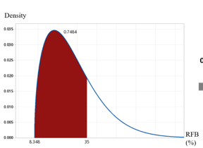
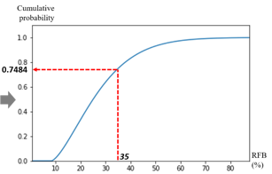
6. Guidance on Historical Data-Driven Approach for Estimating Construction Contingencies
Work Tasks for Historical Data-Driven Approach
1. Historical Cost Data Collection
2. Data Cleaning and Pre-processing
3. Data Analysis and Project Characterization
4. Model Development
5. Apply Model to Projects
Contingency range estimation
Perform statistical analysis.
Probability distribution fitting.
Develop probability density functions (PDF) and cumulative distribution functions (CDF).
<PDF>
<CDF>

Slide 26
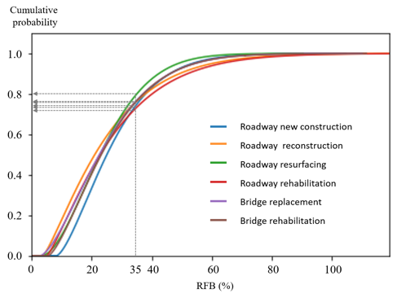
Case Study
6. Guidance on Historical Data-Driven Approach for Estimating Construction Contingencies
CDFs of six project types.
Cumulative probability refers to certainty about a given RFB.
RFB can be a percentage of base cost.
Types | RFB
 | 10% | 30% | 50%
Roadway - new construction | 0.022 | 0.638 | 0.93
Roadway – reconstruction | 0.177 | 0.688 | 0.905
Roadway – resurfacing | 0.101 | 0.697 | 0.966
Roadway – rehabilitation | 0.132 | 0.652 | 0.888
Bridge replacement | 0.136 | 0.677 | 0.928
Bridge rehabilitation | 0.091 | 0.670 | 0.927

Slide 27
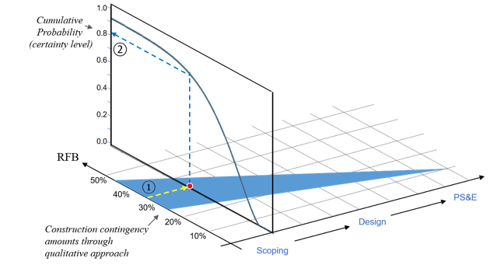
Case Study
6. Guidance on Historical Data-Driven Approach for Estimating Construction Contingencies
Applications (Incorporate CDF into sliding scales)
①: Convert a construction contingency amount to the percentage of the base estimate.
②: Check cumulative probability from CDF curves to ensure the certainty of construction contingency.

Slide 28
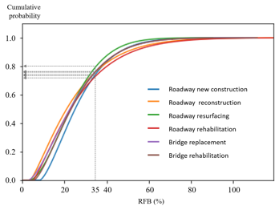
Use of two approaches
6. Guidance on Historical Data-Driven Approach for Estimating Construction Contingencies
Verification: Historical data-driven approach
Estimation: Risk-driven approach
Conduct risk identification and estimate their impacts on construction contingency.
Backcheck the amounts from risk-driven estimating.
Evaluate certainty for verification.

Slide 29
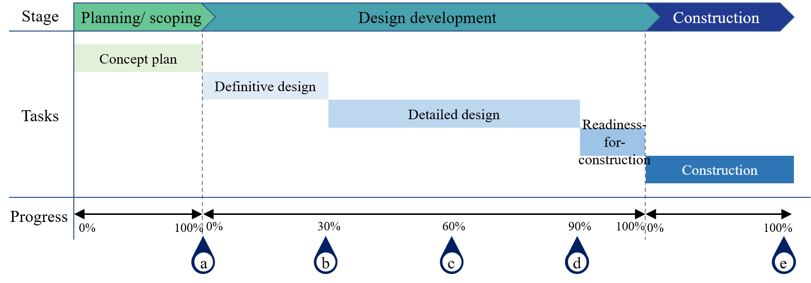
Construction Contingencies Tracking and Monitoring
7. Guidance on Tracking and Monitoring Construction Contingencies
Major milestone meetings for tracking and monitoring
(a) | (b) | (c) | (d) | (e)
End of project scoping | 30% design | 60% design | 90% design | Construction completion

Slide 30
Iterative Process for Tracking and Monitoring Construction Contingencies
7. Guidance on Tracking and Monitoring Construction Contingencies
<MS Excel tool interface for contingency tracking and monitoring>

Slide 31
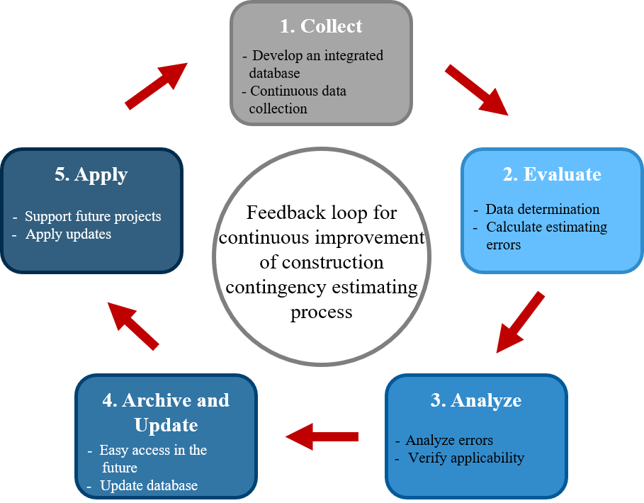
Continuous Improvement of Construction Contingency Estimating Process
7. Guidance on Tracking and Monitoring Construction Contingencies
<Process for feedback loop for construction contingency estimating>

Slide 32
Feedback to djeong@tamu.edu

