Slide 1
August 2023
US & TX Construction Outlook:
Rotation or Retreat?
Ken Simonson
Chief Economist, AGC of America
ken.simonson@agc.org
©2023 The Associated General Contractors of America, Inc.

Slide 2
Total nonfarm & construction employment, Feb. 2020-July 2023
Year-over-year change, seasonally adjusted
% change since:
July 2022
Feb. 2020
Nonresidential Construction
3.1%
0.9%
Total Nonfarm
2.2%
2.6%
Residential Construction
1.8%
10.8%
Source: BLS current employment statistics, https://www.bls.gov/ces/
©2022 The Associated General Contractors of America, Inc.

Slide 3
US & TX Construction Employment
Cumulative change, Feb 2020-July 2023, seasonally adjusted
% change
July 2022-
July 2023:
Feb 2020-
July 2023:
US
2.5%
4.8%
TX
3.2%
4.0%
2/20
6/20
10/20
2/21
6/21
10/21
2/22
6/22
10/22
2/23
6/23
Source: BLS
©2023 The Associated General Contractors of America, Inc.

Slide 4
Texas Metro Construction Employment
July 2019 - July 2023, not seasonally adjusted
Change from:
July
2023
July
2022
July 2019
San Antonio-New Braunfels | 63,100 |  |  | 2% | 11%
Dallas-Fort Worth-Arlington* | 257,300 |  |  | 9% | 12%
Houston-The Woodlands-Sugar Land | 224,600 |  |  | -1% | -5%
Austin-Round Rock* | 84,500 |  |  | 5% | 21%
Source: BLS *The Bureau of Labor Statistics reports employment for construction, mining and logging combined for metro areas in which mining and logging have few employers. Construction-only employment change is shown for a metro if BLS posts that data.
©2023 The Associated General Contractors of America, Inc.

Slide 5
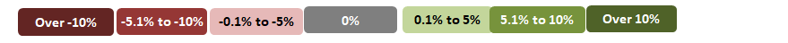
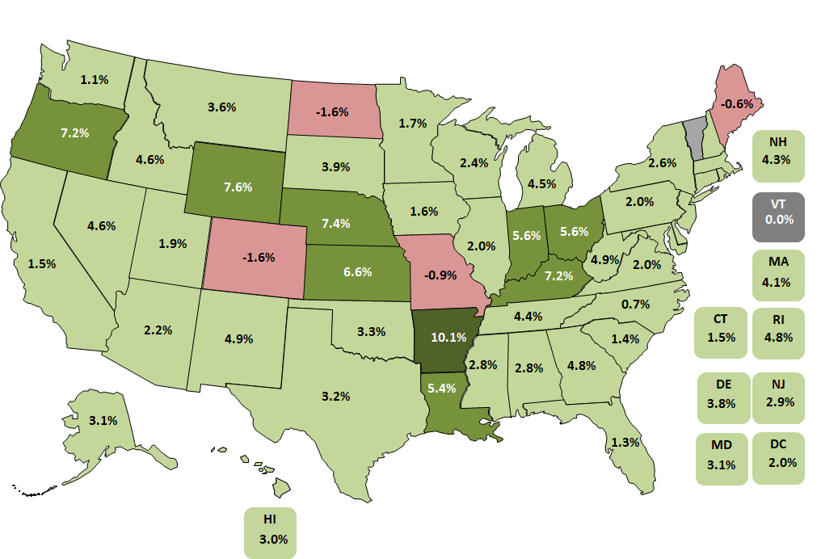
Construction employment change by state, July 2022-July 2023 (U.S.: 2.5%)
45 states & DC up, 4 states down, VT unchanged
Top 5
AR | 10.1%
WY | 7.6%
NE | 7.4%
KY | 7.2%
OR | 7.2%
Bottom 5
CO | -1.6%
ND | -1.6%
MO | -0.9%
MA | -0.6%
VT | 0.0%
Source: Bureau of Labor Statistics, state and area employment, www.bls.gov/sae
©2023 The Associated General Contractors of America, Inc.

Slide 6
Construction job openings & new hires
Job openings and hires, June 2001-June 2023, not seasonally adjusted
Source: Bureau of Labor Statistics, www.bls.gov/jlt, Job Openings & Labor Turnover Survey (JOLTS)
©2023 The Associated General Contractors of America, Inc.

Slide 7
Construction unemployment rate
July 2000-July 2023, not seasonally adjusted
Source: Bureau of Labor Statistics, Current Population Survey (CPS)
©2023 The Associated General Contractors of America, Inc.

Slide 8
Construction wage “premium” vs. total private sector
Excess of average hourly earnings (AHE) for production and nonsupervisory employees in construction vs. private sector
Annual premium, 2000-2019
Monthly premium, Jan. 2020-Jul. 2023
(seasonally adjusted)
2000- 2019 Average premium [21.5%]
% change in AHE Jul. 2022 – Jul. 2023:
Construction | 5.8%
Private | 4.8%
Sources: BLS, www.bls.gov/ces
©2023 The Associated General Contractors of America, Inc.

Slide 9
Construction inputs & labor costs
Year-over-year change in PPI for nonresidential inputs & AHE for production employees in construction, Feb. 2020 – July 2023
Producer price index (PPI) for nonresidential inputs
Average hourly earnings (AHE) for production employees in construction
% change since:
July 2022
AHE
5.8%
PPI Inputs
-2.3%
Source: Bureau of Labor Statistics, PPI, www.bls.gov/ppi ; Current Employment Statistics, AHE, https://www.bls.gov/ces/
©2023 The Associated General Contractors of America, Inc.

Slide 10
Not all construction costs are cooling!
producer price indexes, 1 - & 12-mo. change (not seasonally adjusted)
July 2023 change from:
June 2023 July 2022
(1 month) (12 months)
Cement |  | 1.7% | 12.6%
Ready-mix concrete |  | 0.6% | 10.4%
Construction machinery and equipment |  | 1.6% | 9.3%
Subcontractor price indexes, nonresidential building work
Roofing contractors |  | -0.1% | 12.2%
Electrical contractors |  | -1.5% | 4.5%
​Plumbing contractors |  | 0.2% | 6.5%
Concrete contractors |  | -2.7% | -1.2%
Source: BLS, producer price indexes, www.bls.gov/ppi
©2023 The Associated General Contractors of America, Inc.

Slide 11
Cost squeeze on contractors can reappear suddenly, last 2+ years
Difference between year-over-year change in materials costs vs. bid prices, Jan 2007-Jul 2023
Difference between year-over-year change in materials costs vs. bid prices, Jun 2020-Sep 2021
Dec 2020- June 2022
19 months
= period when change in costs exceeded change in bid prices
Dec 2009- Jan 2012
26 months
Oct 2016- Nov 2018
25 months
2022
2023
Source: BLS, www.bls.gov/ppi, producer price indexes for goods inputs to nonresidential construction (material costs) and new school building construction (bid prices)
©2023 The Associated General Contractors of America, Inc.

Slide 12
Change in construction spending: June 2023 vs. June 2022
Year-over-year % change in current (not inflation-adjusted) dollars, seasonally adjusted
Source: Author, from U.S. Census Bureau, www.census.gov/constructionspending
©2023 The Associated General Contractors of America, Inc.

Slide 13
Change in construction spending: June 2023 vs. June 2022
current (not inflation-adjusted) dollars, seasonally adjusted
Total 3%: Private residential -10% (single-family -21%; multi 22%; improvements -5%); public residential 7%
Nonresidential 18% (private 21%, public 14%)
Nonresidential segments (in descending order of June 2023 spending; combined new & renovation spending)
Mfg. 80% (computer/electronic 237%; chemical 23%; food/beverage/tobacco 18%; transportation equipment -2%)
Highway and street 20%
Commercial 4% (warehouse 3%; retail 2%; farm 15%)
Power 5% (electric 8%; oil/gas fields & pipelines -7%)
Education 8% (primary/secondary 6%; higher ed 10%)
Office (including data centers) 8%
Transportation 9% (air 8%; private rail/truck 13%; transit -6%)
Health care 11% (hospital 11%; medical building 15%; special care -10%)
Other: Sewage/waste 24%; Amuse/recreation 6%; Water supply 6%; Communications 1%; Lodging 20%; Conservation/development 30%
Source: Author, from U.S. Census Bureau, www.census.gov/constructionspending
©2023 The Associated General Contractors of America, Inc.

Slide 14
Medium-term outlook for construction
Economic recovery should continue but risk of recession remains
Homebuilding appears poised for slow recovery
Multifamily, warehouse, retail, office, lodging are at risk from rising financing costs
Data center and manufacturing construction should remain hot
Infrastructure Investment & Jobs Act, “Chips” Act, Inflation Reduction Act will give major boost to infrastructure, manufacturing, and power construction. BUT
- money will be slow to turn into construction awards and spending
- Buy America(n), labor, environmental strings may tie up project starts for years
Materials cost and lead time trends are mixed, no longer all upward
Labor availability has resumed being the #1 challenge for many contractors
Source: Author
©2023 The Associated General Contractors of America, Inc.

Slide 15
Long-run construction outlook
Finding workers will be a challenge for much longer than materials costs or supply
Slower population growth means slower demand growth for most construction
Slowing demand for K-12, decline for higher ed construction
Permanent shift from retail to e-commerce/distribution structures
More specialized and online healthcare facilities; fewer hospitals, nursing homes
More wind, solar, battery storage and charging facilities, and related manufacturing
Not clear if offices will decentralize or remain in less demand
Not clear if recent urban/rural or state-to-state migration will remain or reverse
Source: Author
©2023 The Associated General Contractors of America, Inc.

Slide 16
Population change by state, July 2021–July 2022
(U.S.: 0.38%)
Decrease
0-0.49%
0.5-0.99%
1.0-1.49%
1.5%+
0.6%
1.8%
Top 6
FL | 1.9%
ID | 1.8%
SC | 1.7%
TX | 1.6%
SD, MT | 1.5%
1.5%
0.6%
-0.4%
0.2%
0.1%
NH
0.6%
0.2%
-0.9%
VT
0.01%
0.3%
1.5%
-0.03%
-0.3%
1.0%
0.1%
-0.3%
MA
-0.1%
1.2%
0.2%
-0.8%
-0.1%
0.5%
0.3%
-0.6%
-0.03%
0.1%
0.3%
CT
0.1%
RI
-0.3%
0.1%
Bottom 5
NY | -0.9%
IL | -0.8%
LA | -0.8%
WV | -0.6%
HI | -0.5%
1.3%
1.3%
-0.2%
0.7%
1.2%
DE
1.4%
NJ
-0.1%
1.6%
0.6%
1.7%
-0.3%
0.4%
1.2%
MD
-0.2%
DC
0.5%
AK
-0.1%
-0.8%
1.9%
HI
-0.5%
Source: U.S. Census Bureau, Dec. 2022 population estimates, www.census.gov/popest
©2023 The Associated General Contractors of America, Inc.

Slide 17
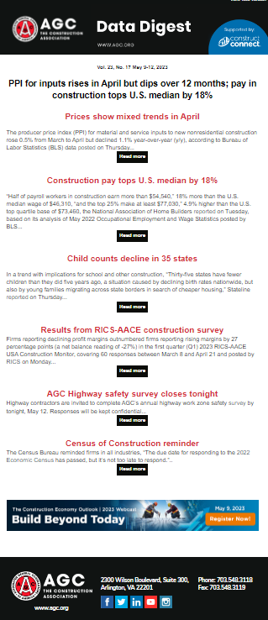
AGC economic resources
(email ken.simonson@agc.org)
Data DIGest: weekly 1-page email (subscribe at http://store.agc.org)
ConsensusDocs Price Escalation Resource Center: https://www.consensusdocs.org/price-escalation-clause/
Surveys, state and metro data, fact sheets: www.agc.org/learn/construction-data
Monthly press releases: construction spending; producer price indexes; national, state, metro employment with rankings: https://www.agc.org/newsroom
Source: Author
©2022 The Associated General Contractors of America, Inc.

