Slide 1

NHCCI
National Highway Construction Cost Index
POC: Thor Dodson, Economist, PhD thor.dodson@dot.gov
Transportation Policy and Strategy Analysis Team,
Office of Transportation Policy Studies
https://www.fhwa.dot.gov/policy/otps/nhcci/

Slide 2
What is The NHCCI?
Is an average cost index of a basket of components or goods and services for highway construction contracts across the United States
  The basket consists of winning bids for state DOTs highway construction projects.
  Measures highway construction inflation, the purchasing power of a dollar highway investment
NHCCI replaced the old Bid-Price Index (BPI) , which was calculated using information submitted for Federal-aid construction contracts over $500,000. https://www.fhwa.dot.gov/programadmin/pt2006q1.cfm
Produced and released on the FHWA website quarterly with three months time lag
Different than PPI’s as includes cost of transportation, profit, installation
Source data only covers Federal-aid projects
Source:FHWA

Slide 3
Input Data
BidTabs data is the primary input data
  Contains State names, pay-items and description, quantity, unit, price, and contract award date
 | PayItem | Description | Quantity | Unit | Price | jobno | BidDate | County | Category
 | 201A-002 | CLEARING AND GRUBBING (MAX ALLOWABLE BID $ | 1 | L.S. | 60000 | 2.01E+10 | 7/27/2012 | JEFFERSON | 13
AL | 206A-050 | REMOVAL OF OLD BRIDGE, PARTIAL, STATION | 1 | L.S. | 57271.88 | 2.01E+10 | 7/27/2012 | JEFFERSON | 13
AL | 206C-001 | REMOVING CONCRETE PAVEMENT | 110870 | S.Y. | 13.45 | 2.01E+10 | 7/27/2012 | JEFFERSON | 13
AL | 206C-002 | REMOVING CONCRETE SLOPE PAVING | 689 | S.Y. | 19.49 | 2.01E+10 | 7/27/2012 | JEFFERSON | 13
AL | 206C-013 | REMOVING BRIDGE END SLAB | 6041 | S.Y. | 34.1 | 2.01E+10 | 7/27/2012 | JEFFERSON | 13
AL | 206D-001 | REMOVING GUARDRAIL | 16402 | L.F. | 1.42 | 2.01E+10 | 7/27/2012 | JEFFERSON | 13
AL | 206D-010 | REMOVING SAFETY BARRIER | 4031 | L.F. | 32.88 | 2.01E+10 | 7/27/2012 | JEFFERSON | 13
AL | 2.06E-06 | REMOVING GUARDRAIL END ANCHOR (ALL TYPE) | 150 | EACH | 141.67 | 2.01E+10 | 7/27/2012 | JEFFERSON | 13
AL | 2.06E-39 | REMOVING IMPACT ATTENUATORS | 8 | EACH | 566.69 | 2.01E+10 | 7/27/2012 | JEFFERSON | 13
AL | 210A-000 | UNCLASSIFIED EXCAVATION | 42514 | CYIP | 14.61 | 2.01E+10 | 7/27/2012 | JEFFERSON | 1
AL | 210D-001 | BORROW EXCAVATION (LOOSE TRUCKBED MEASUREMENT) | 2500 | CYIP | 24.36 | 2.01E+10 | 7/27/2012 | JEFFERSON | 1
AL | 230A-000 | ROADBED STATION ROADBED PROCESSING | 228 | STA. | 462.8 | 2.01E+10 | 7/27/2012 | JEFFERSON | 1
AL | 405A-000 | TACK COAT | 43618 | GAL | 3.66 | 2.01E+10 | 7/27/2012 | JEFFERSON | 3
AL | 407B-000 | JOINT SEALANT FOR HOT MIX ASPHALT PAVEMENT | 87 | MILE | 229.02 | 2.01E+10 | 7/27/2012 | JEFFERSON | 3
Purchased from Oman Systems, Inc
Oman collects the data from State web-postings of winning bids on highway construction contracts
Covers all states, except Hawaii, Alaska and DC
Some difficulties stem from inconsistent pay-item classification, both across and within States

Slide 4
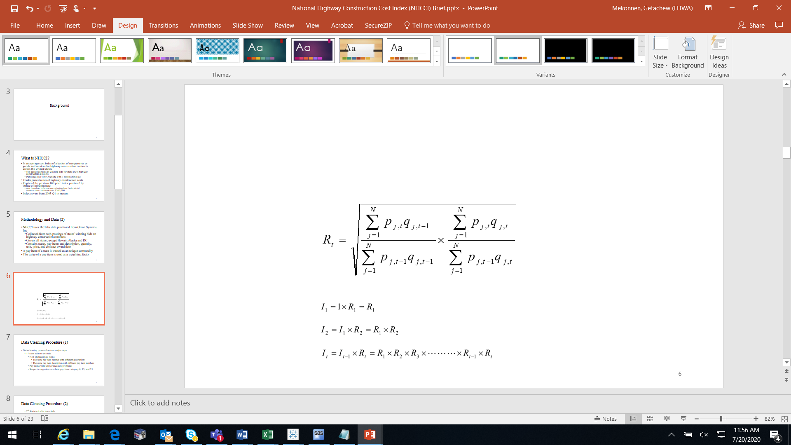
How is NHCCI Calculated?
Calculated using chained fisher index formula
  A geometric mean of Laspeyres Index and Paasche Index
The value (quantity*price) of a pay item is used as a weighting factor
A pay item is a unit of work, construction material, labor, or service for which price and quantity is provided in the contract

Slide 5
NHCCI Products
NHCCI
Seasonally Adjusted NHCCI
Component Contributions
Analysis and Narrative Article
Visit the NHCCI website for quarterly updates
https://www.fhwa.dot.gov/policy/otps/nhcci/

Slide 8
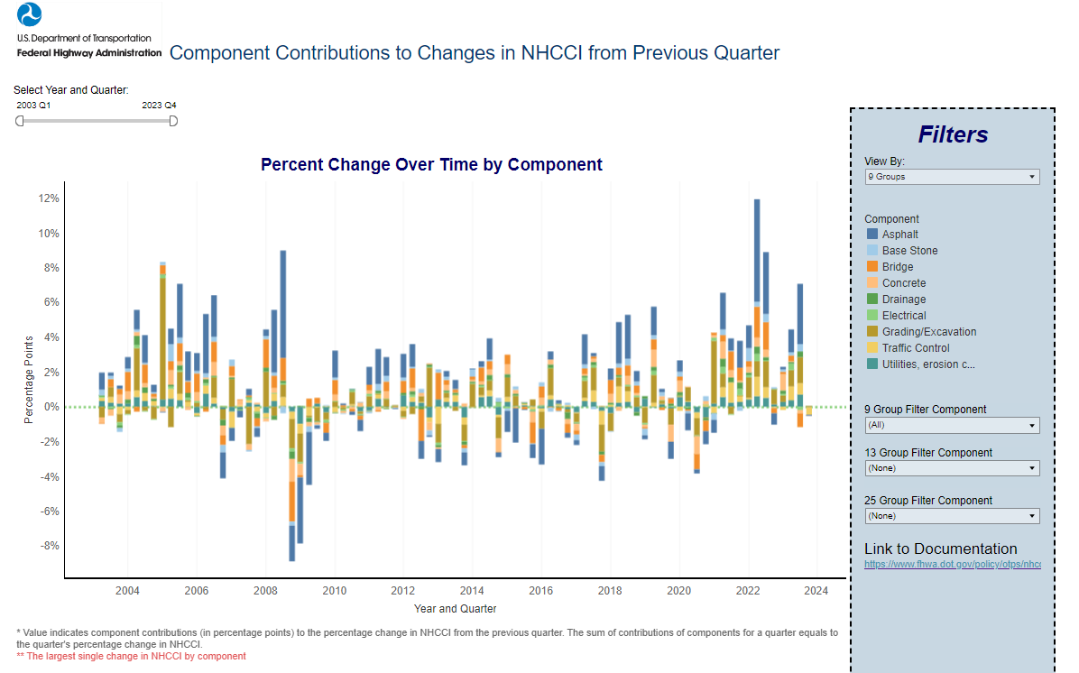

Slide 9
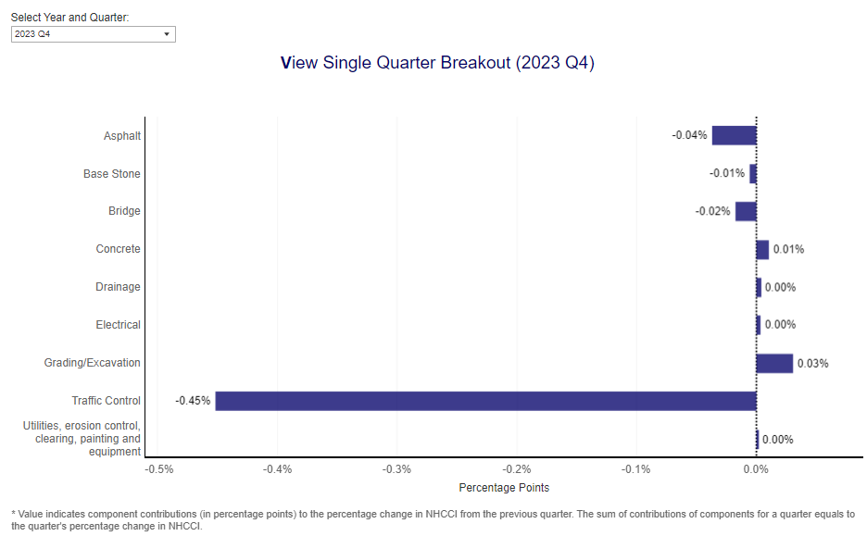

Slide 10
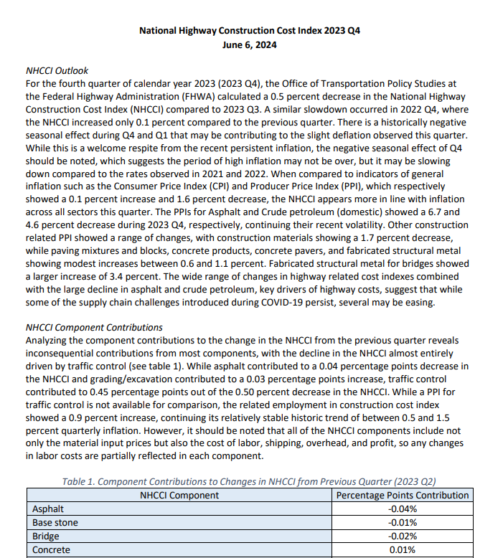
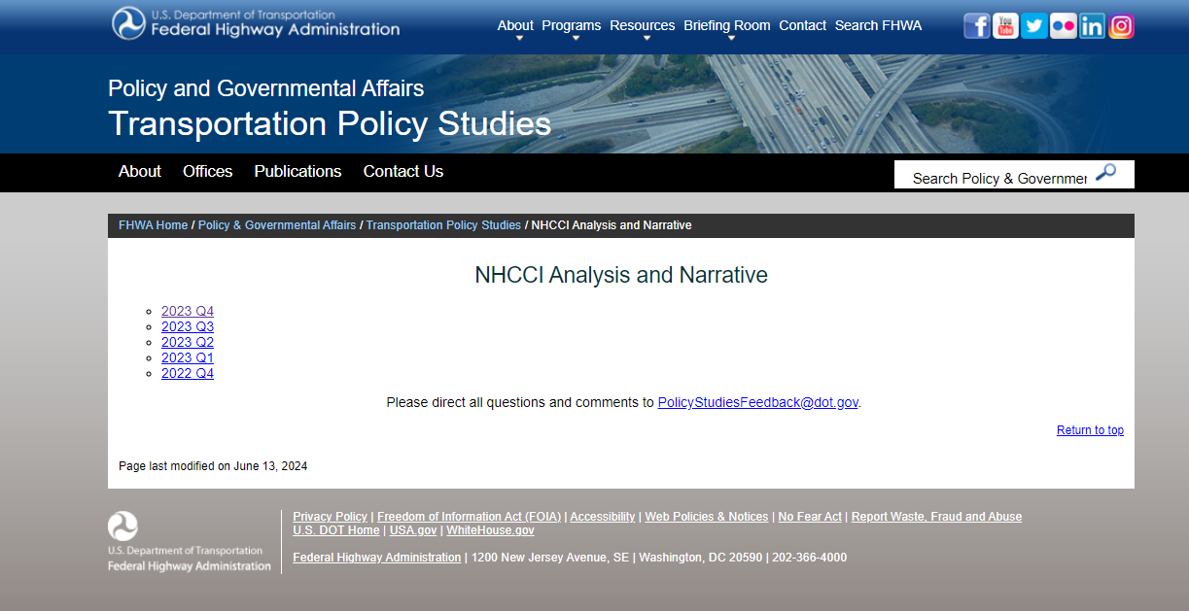
NHCCI Analysis and Narrative
https://www.fhwa.dot.gov/policy/otps/nhcci/narrative.cfm

Slide 11
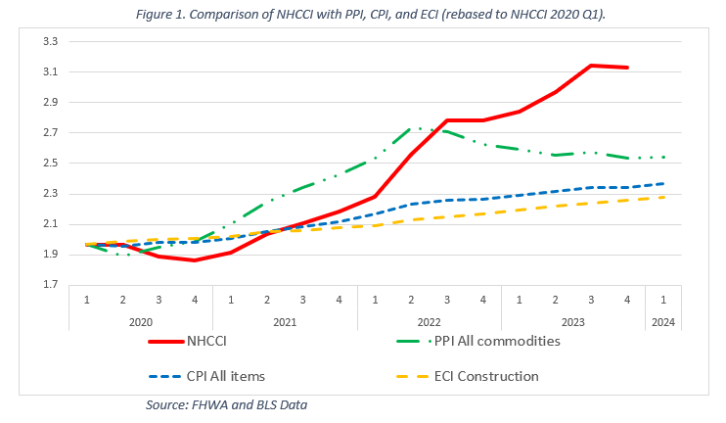

Slide 12
Source: FHWA and BLS

Slide 13
Source: FHWA and BLS

Slide 15
Source: US Census Bureau

Slide 16
Source BLS

Slide 17
Source: FHWA and BLS

Slide 18
Thank you
→ Please reach out with any NHCCI related questions to NHCCI@dot.gov
NHCCI Homepage:
https://www.fhwa.dot.gov/policy/otps/nhcci/
POC: Thor Dodson, Economist, PhD thor.dodson@dot.gov
Transportation Policy and Strategy Analysis Team,
Office of Transportation Policy Studies

